Slide 1
Unsupervised Learning Techniques

Slide 2
Agenda
Supervised vs Unsupervised Learning
Clustering Techniques
Applications of Clustering
Distance between Two Points
K-Means Clustering
Hierarchical Clustering
Principal Component Analysis

Slide 3
Supervised vs Unsupervised Learning
Supervised Learning | Unsupervised Learning
There is a response variable/ labels in the data to guide the learning process | There is no response variable/ labels to guide the learning
Techniques - Regression, Classification etc. | Techniques - Clustering, Principal Component Analysis etc.
Evaluation metrics can be used to assess the model | Evaluation of the clusters has subjectivity
Example - Predicting salary of employees based on their Experience, Skill, Location and Technology | Example - Grouping of customers based on Recency, Frequency and Monetary value of their transactions

Slide 4
Clustering Techniques
Managerial Clustering
Rule based
Statistical Clustering
K-Means
Hierarchical
DBScan
K-Mode (categorical data)
K-Prototype (mixed data)

Slide 5
Applications of Clustering
Market Segmentation
Customer Profiling
Recommender Systems
Image Segmentation
Document Analysis
Search Engines

Slide 6
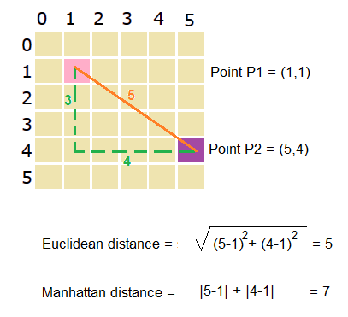
Distance between Two Points
Reference -https://prismoskills.appspot.com/

Slide 7
K-Means Clustering
Decide the number of clusters you want i.e. value of K
Elbow method
Silhouette score
Subject knowledge
Initialize the clusters by randomly choosing k data points
Assign the nearest observations to the corresponding cluster
Use Euclidean/ Manhattan distance to calculate distance between observations
Update the cluster centroid
Repeat steps 3 and 4 until the clusters are stable

Slide 8
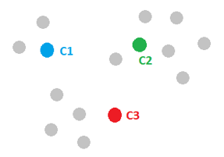

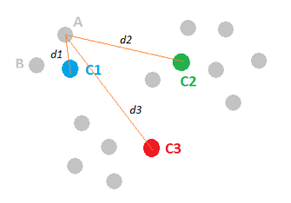
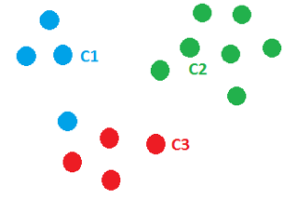
K-Means Clustering
Step 2
Step 1
Step 3
Step 4

Slide 9
Hierarchical Clustering (Agglomerative)
Each observation is considered to be a cluster
Fuse the closest clusters into a single cluster
Choose a linkage method
Compute the distance between the new cluster and other clusters
Repeat steps 2 and 3 until all the observations are merged into a single cluster
Divisive Clustering starts with all the observations in a single cluster, and then at each step it is split into smaller clusters until each cluster contains just one observation

Slide 10
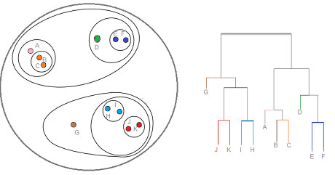
Hierarchical Clustering
More the distance of the vertical lines in the dendrogram, more the distance between those clusters
Number of clusters is the number of vertical lines intersected by the horizontal line drawn on Dendrogram

Slide 11
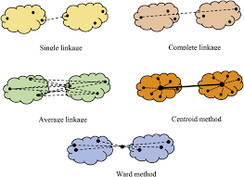
Linkage Methods
Single Linkage
nearest observations in two clusters
Complete Linkage
farthest observations in two clusters
Average Linkage
Average of all the pairwise distances
Ward’s method
utilizes the distance between a central point in each cluster

Slide 12
Principal Component Analysis
Applications -
Dimension reduction
Feature extraction
Reducing computational expense in model execution
Data Visualization
Handling multicollinearity

Slide 13
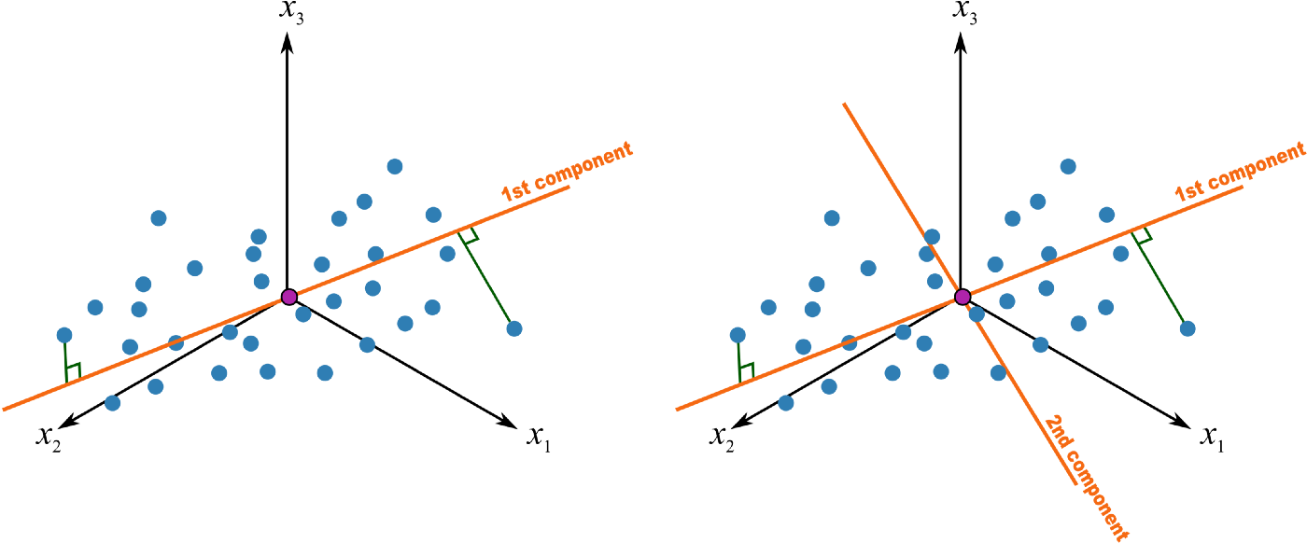
Principal Component Analysis
Reference -https://heartbeat.fritz.ai/

